Slide 1
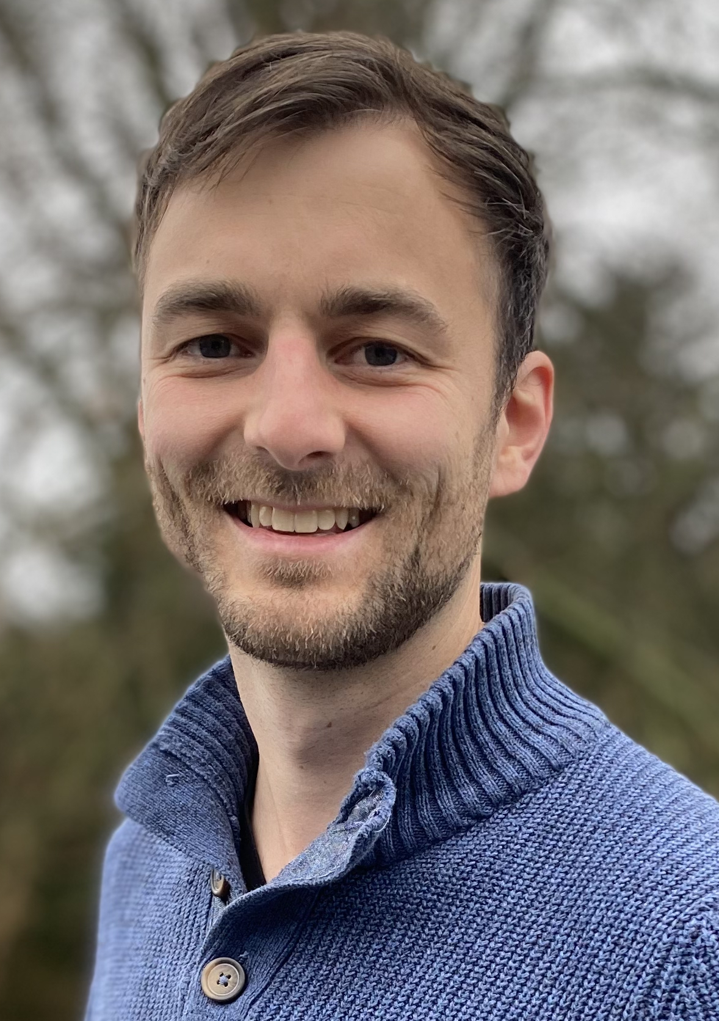
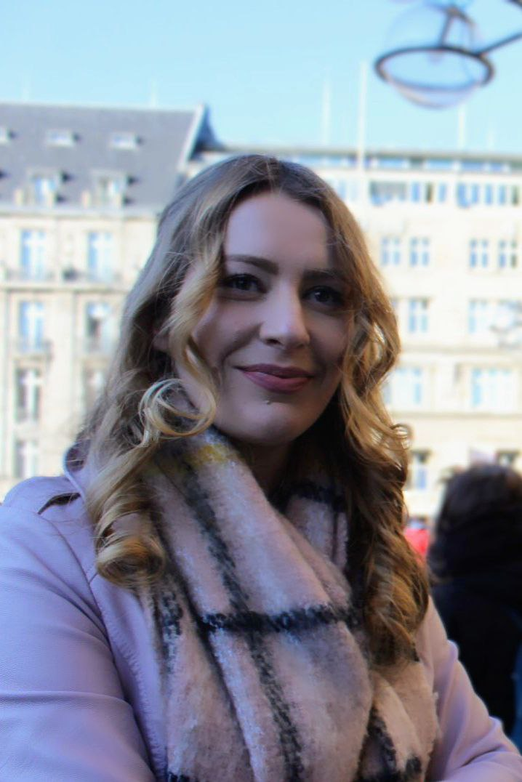
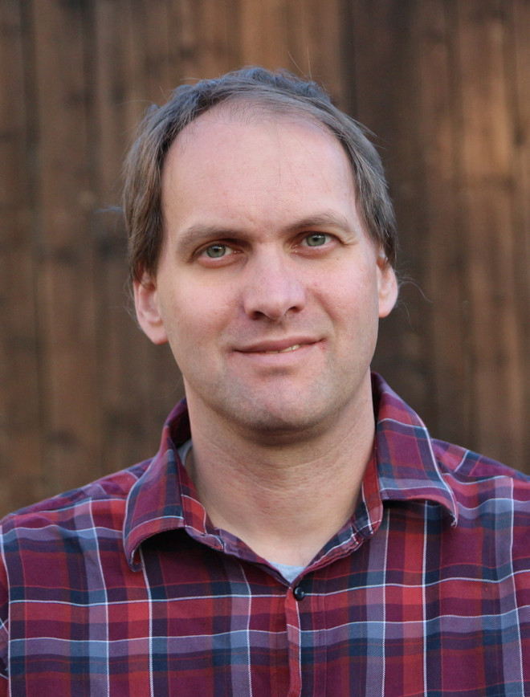
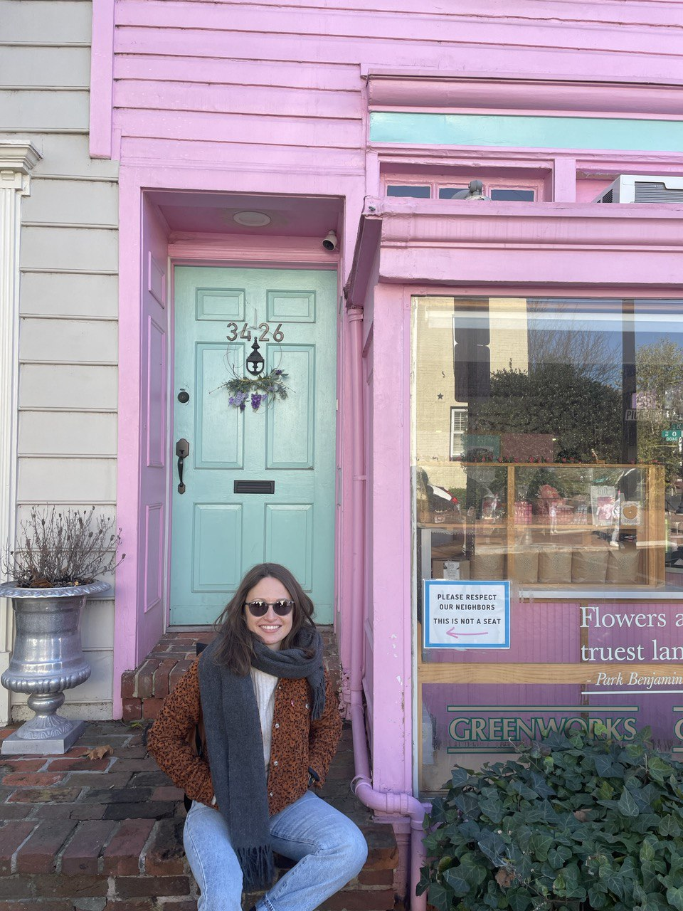
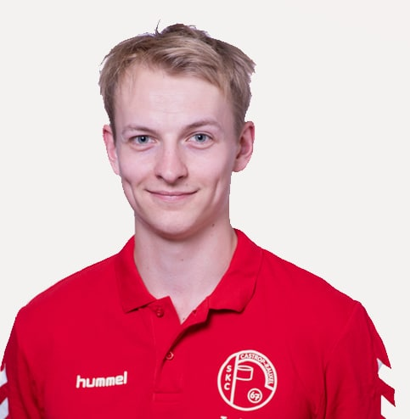
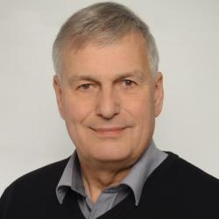

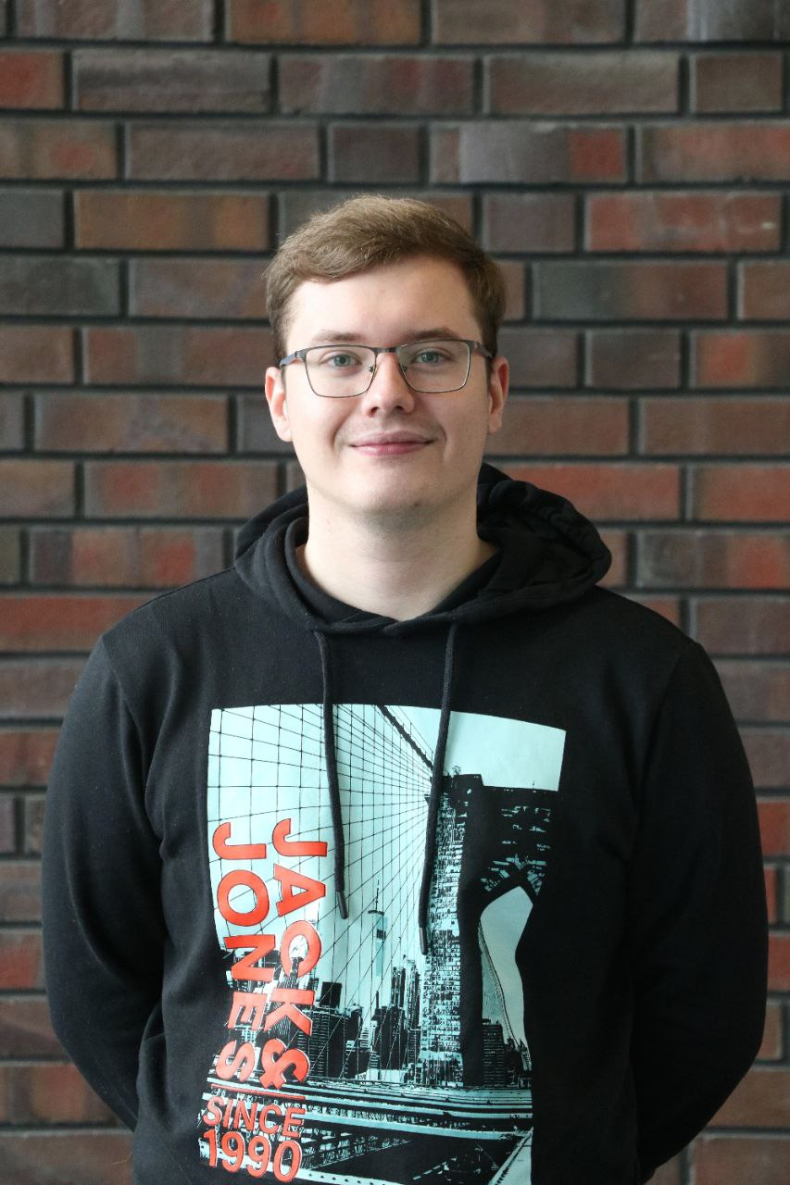
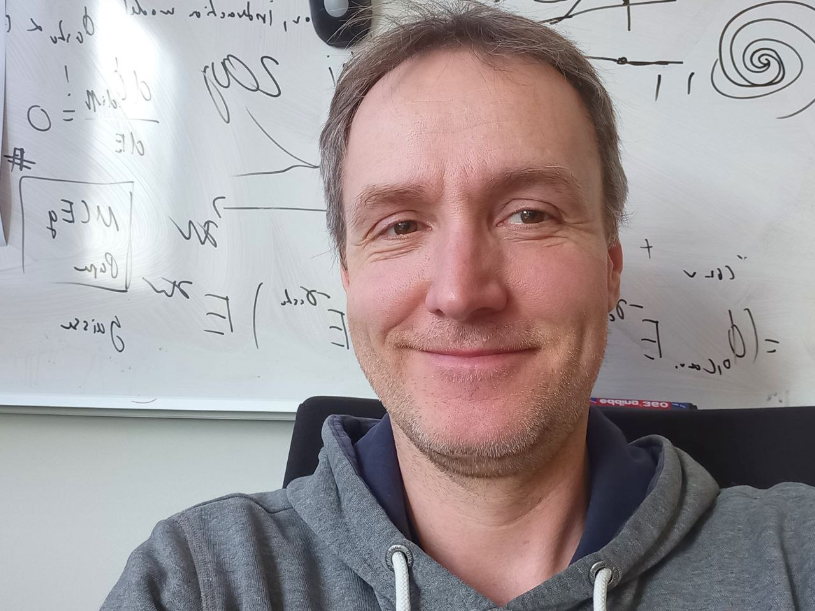
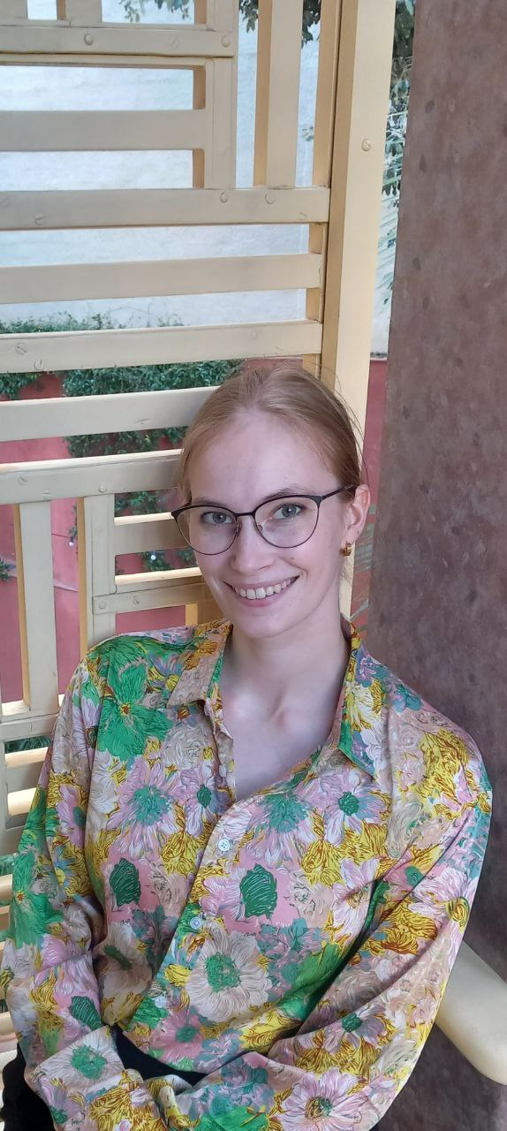
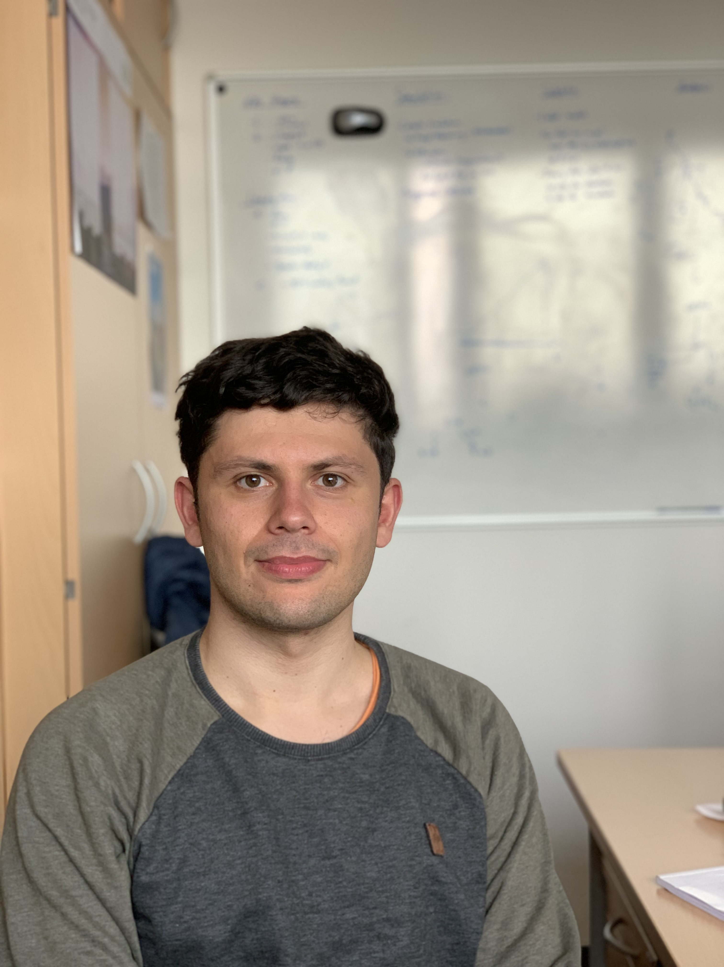
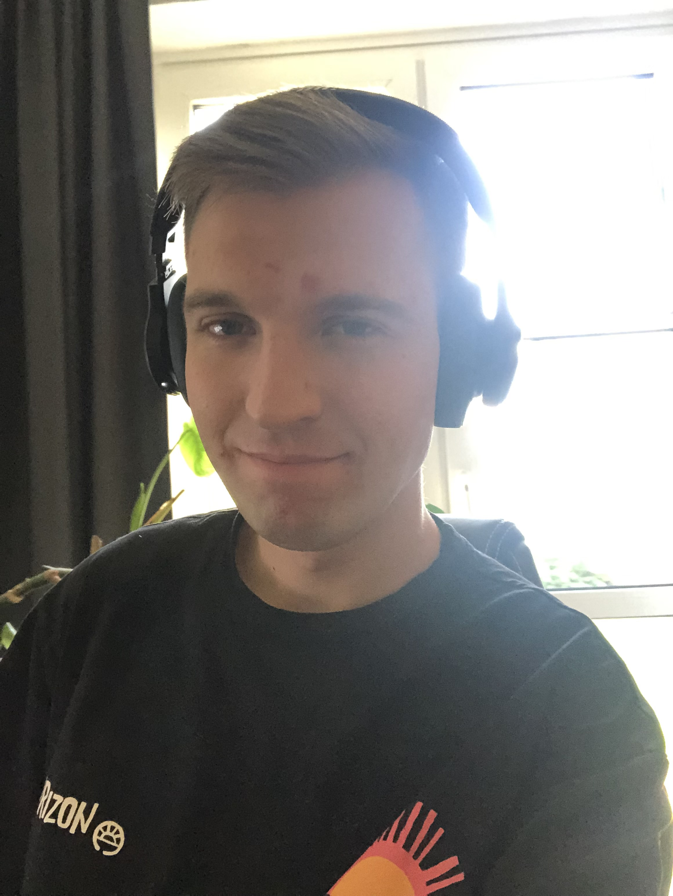
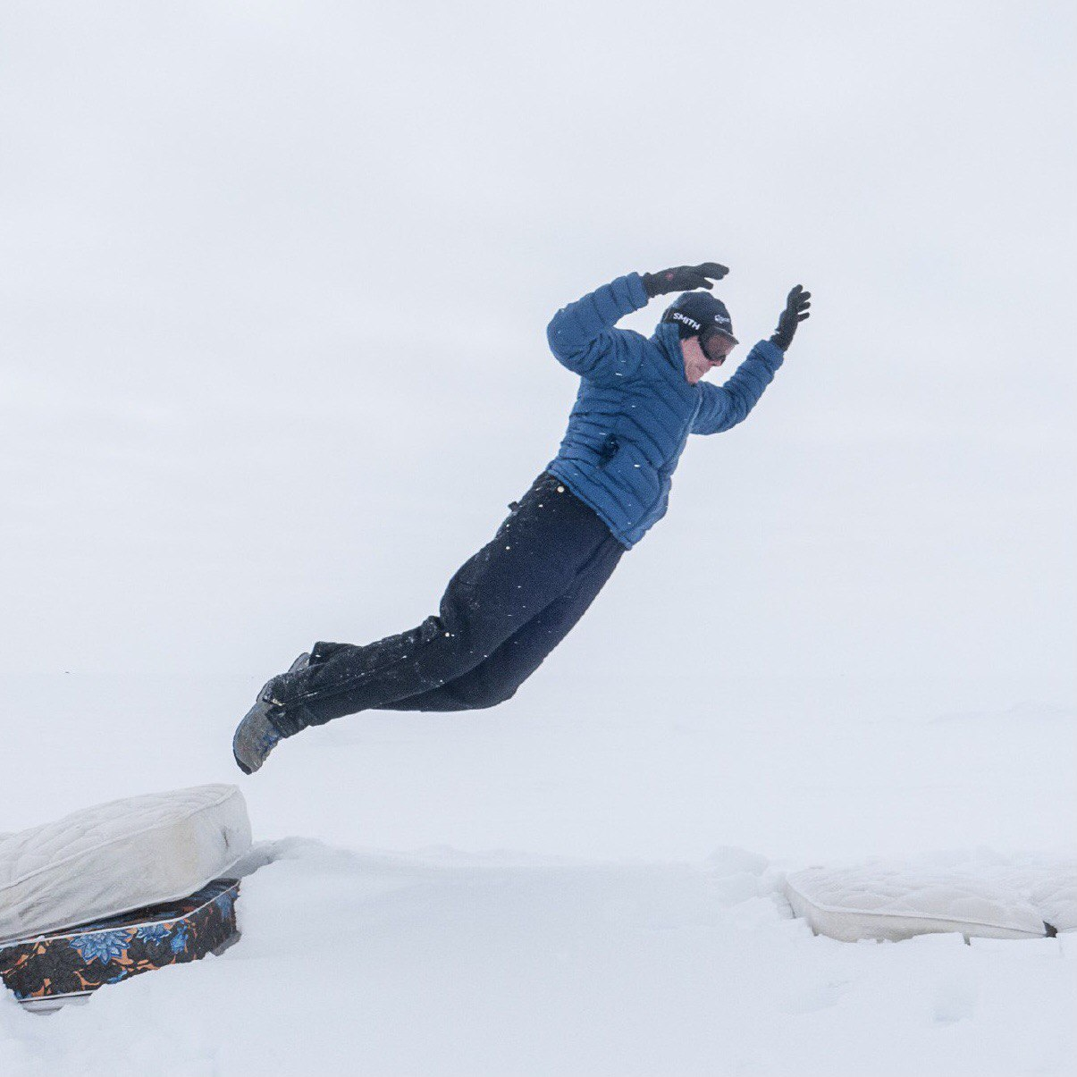
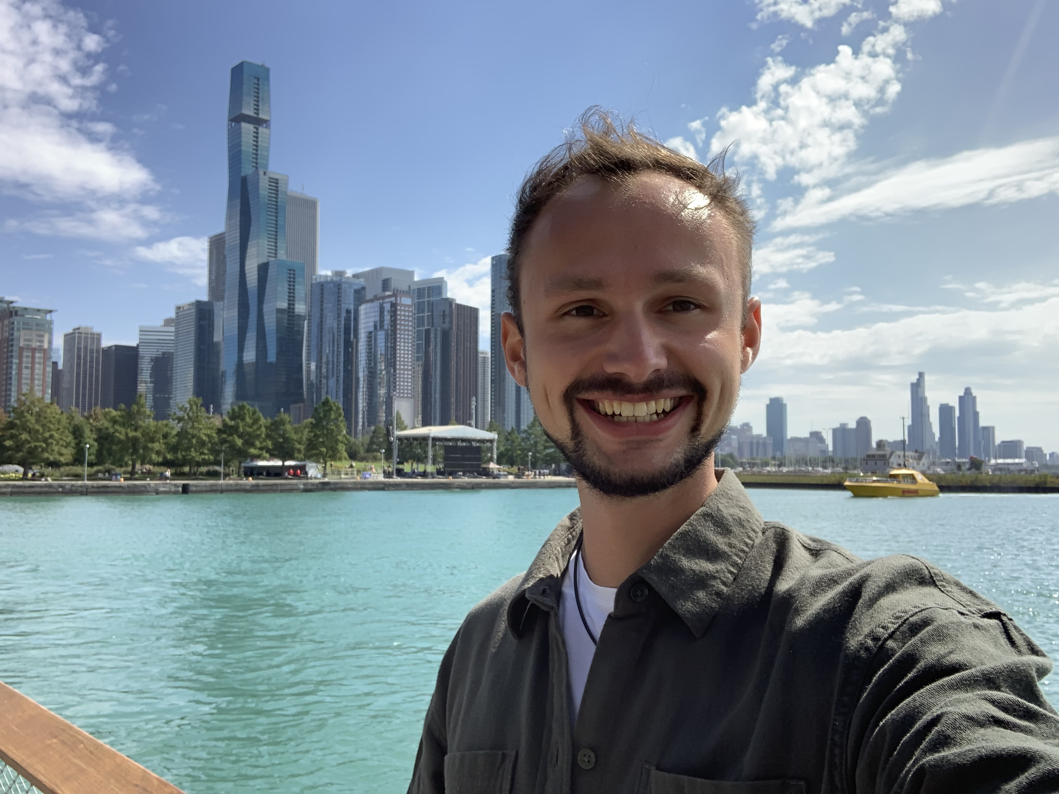
Mirco Hünnefeld
(Post doc)
Leonora Kardum
(PhD student)
Karolin Hymon
(PhD student)
Lucas Witthaus
(PhD student)
Wolfgang Rhode
(Prof.)
Dominik Elsässer
(Post doc)
Lars Bollmann
(Master student)
Tim Ruhe
(Post doc)
Samuel Haefs
(Master student)
Deborah Kramps
(Master student)
Johannes Werthebach
(PhD student)
Jean-Marco Alameddine
(PhD student)
Pascal Gutjahr
(PhD student)

